Slide 1
Day 3
AI Based Computer Vision Accident Detection
Reuben George Mathew
Jeffrey Aaron Paul
Rohan Jamadagni
Sandeep S Budhya
RG Shruthii
Jennifer Jeeyar
Runtime Terror
DSCE, Bangalore
PS Number: IC463
Category: Smart Cities (AICTE)

Slide 2
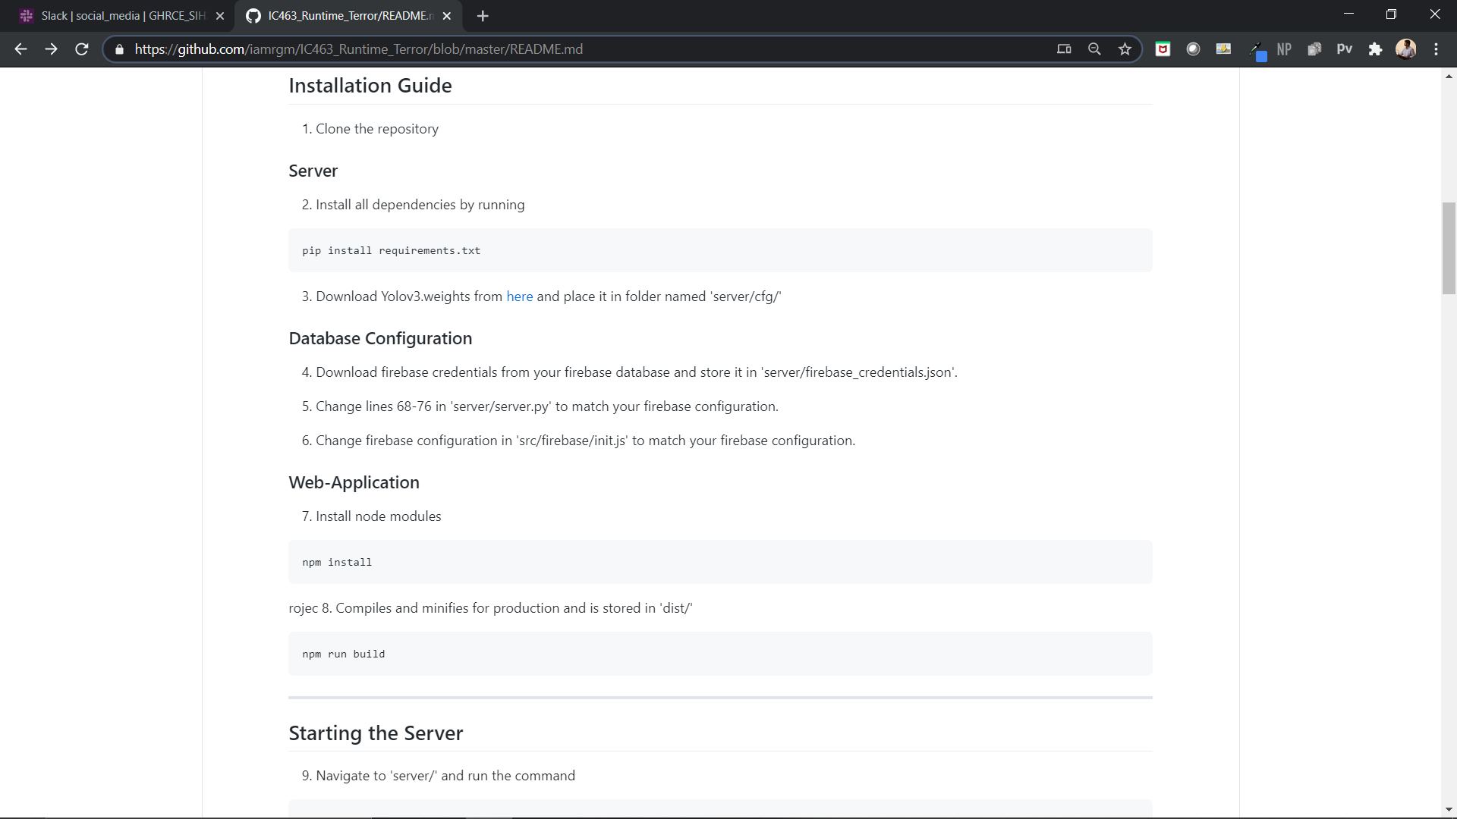
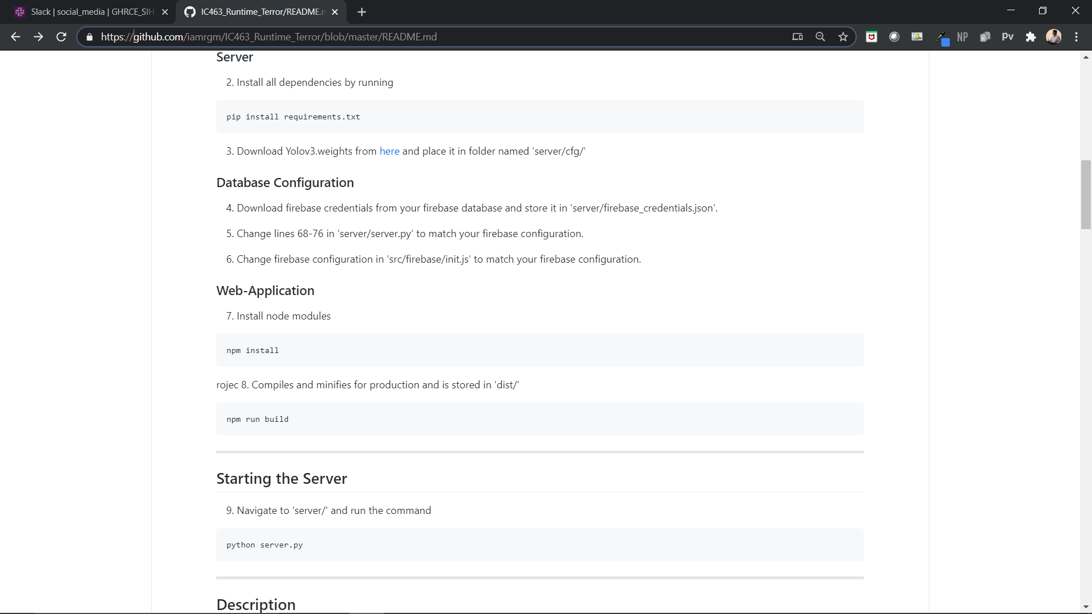
Set Up

Slide 3
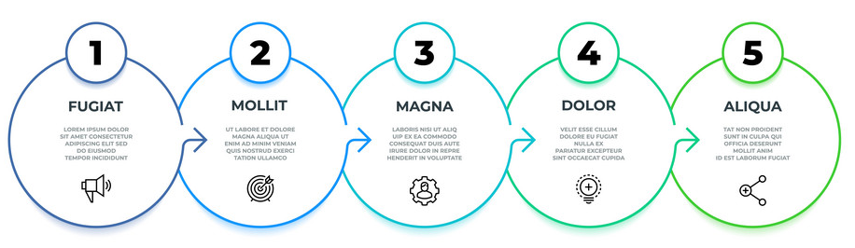
Approach
Capture Footage and Split into frames
Apply Object Detection
Custom Collision Detection Algorithm
Classify Image as Accident/
Not Accident
Send Required Information to Web-Application
OpenCV
Pytorch YOLOv3
Math
Formulae
Keras/ Tensorflow
Vue.js/
Firebase

Slide 4
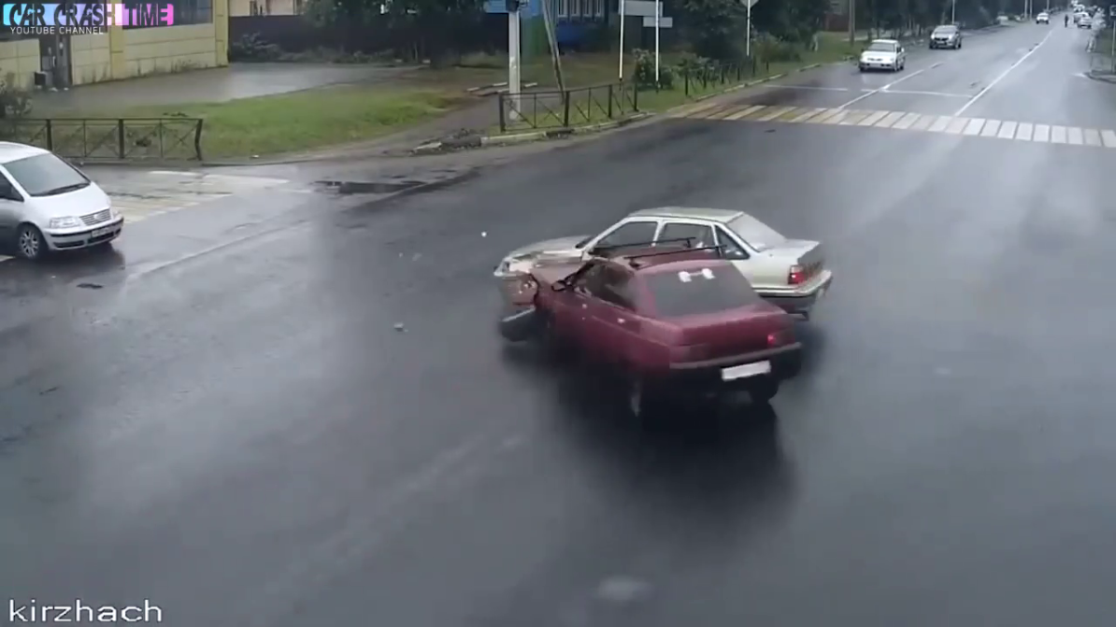
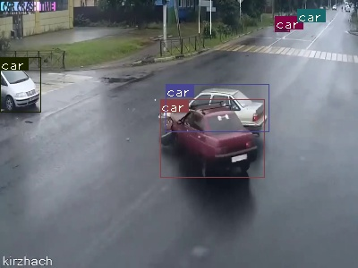
YOLO Object Detection At Work
Image Frame Extracted From Video
Bounding Boxes Marked On Frame

Slide 5
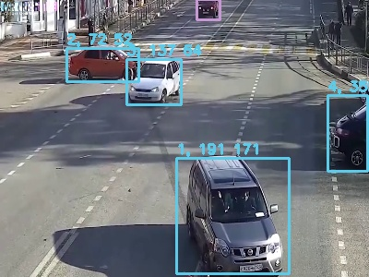
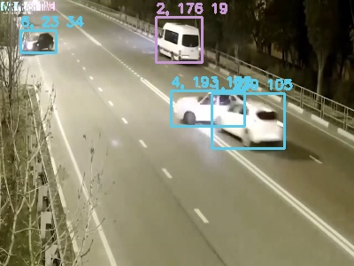
Algorithm Evolution
Difference Between Y Centres
Half Height Sum
Difference Between X Centres
Half Width Sum
Intersection Over Union
Half Width Difference

Slide 6
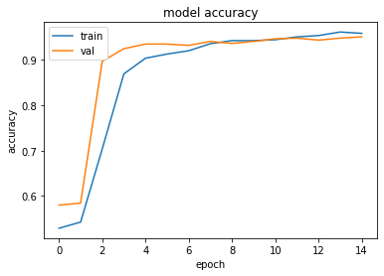
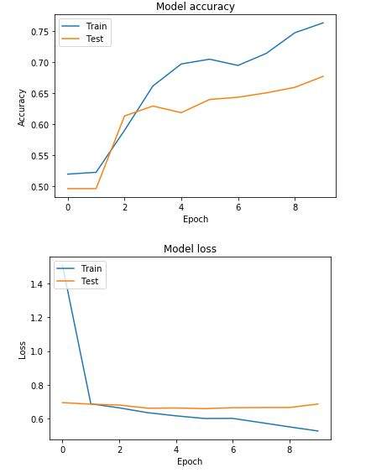
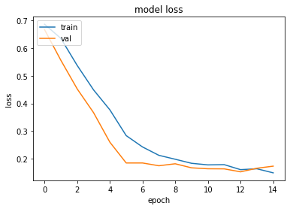
Model Evolution
Old CNN Model
New DenseNet+ANN Model

Slide 7
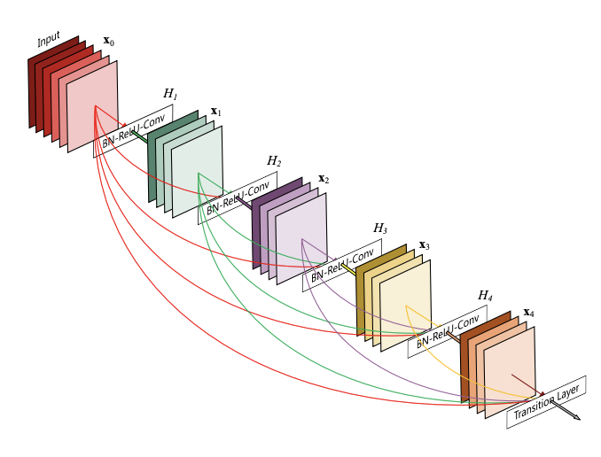
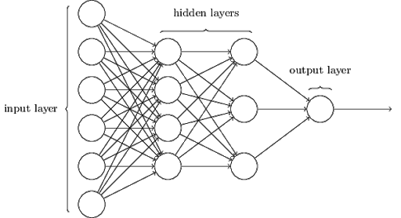
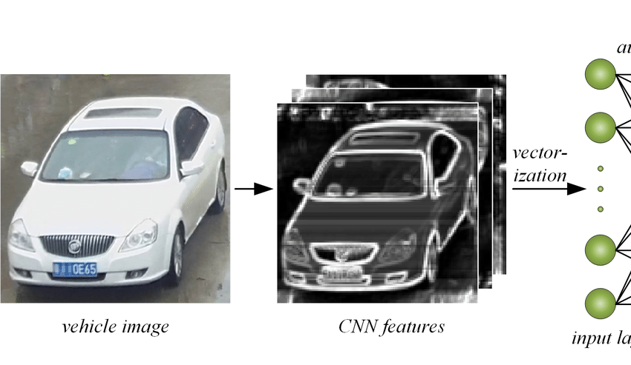
DenseNet+ANN Model Flow
10
DenseNet-201
A Pre-Trained model by Google used for feature extraction
Outputs Score Between 0 and 1
Captured Frame
1920 Shaped Feature Array

Slide 8
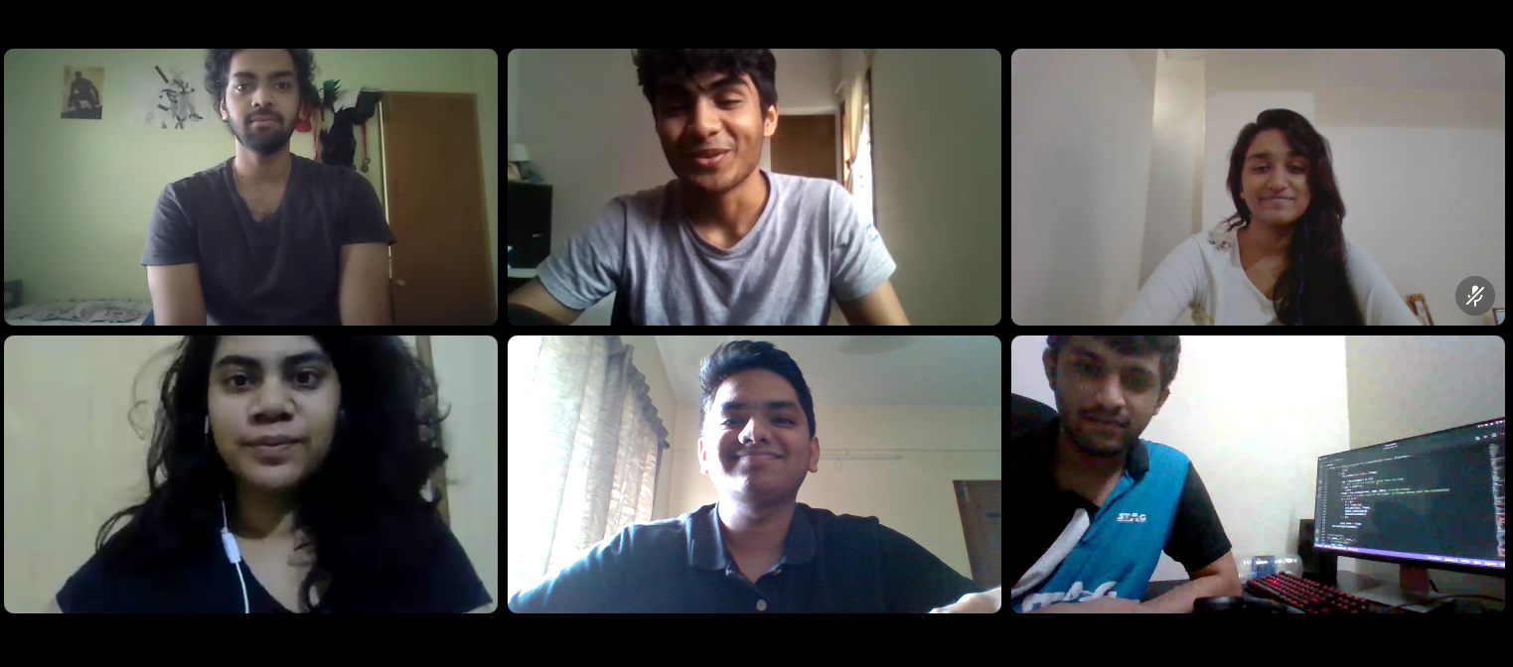
Team Runtime Terror
Sandeep S Budhya
Jeffrey Aaron Paul
Jennifer Jeeyar
RG Shruthii
Reuben George Mathew
Rohan S Jamadagni

